Slide 1
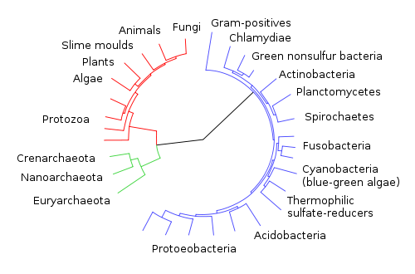
Phylogenetics
Santie de Villiers

Slide 2
What is phylogenetics?
study of evolutionary relatedness among groups of organisms, achieved by:
Comparison of molecular data
Comparison of morphological data
Aim: Reconstructing the evolutionary history of organisms

Slide 3

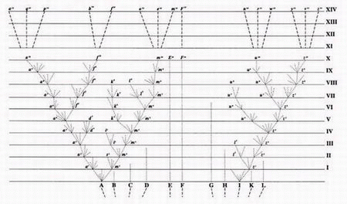
Pioneering phylogenetic thinking
On the Origin of Species by Natural Selection, 1859
Notes:
Charles Darwin (1809–1882) was the first to produce an evolutionary tree of life. From A, diverging lines show branching descent producing new varieties, some of which go extinct, so that after ten thousand generations descendants of A have become distinct new varieties or even sub-species

Slide 4
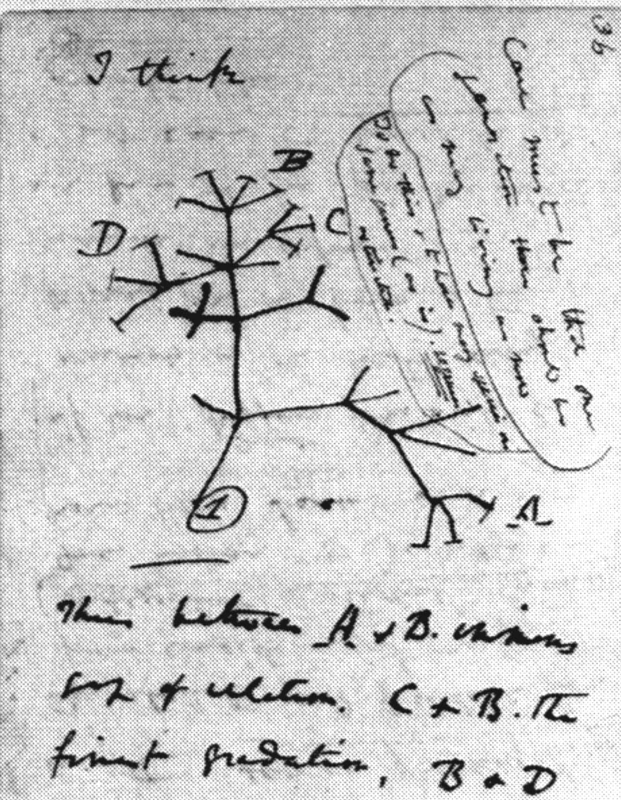
Pioneering phylogenetic thinking
One of Darwin’s notebooks
showing evolutionary
tree-thinking...
Notes:
Charles Darwin (1809–1882) was the first to produce an evolutionary tree of life.

Slide 5
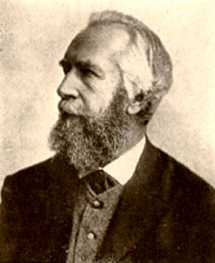
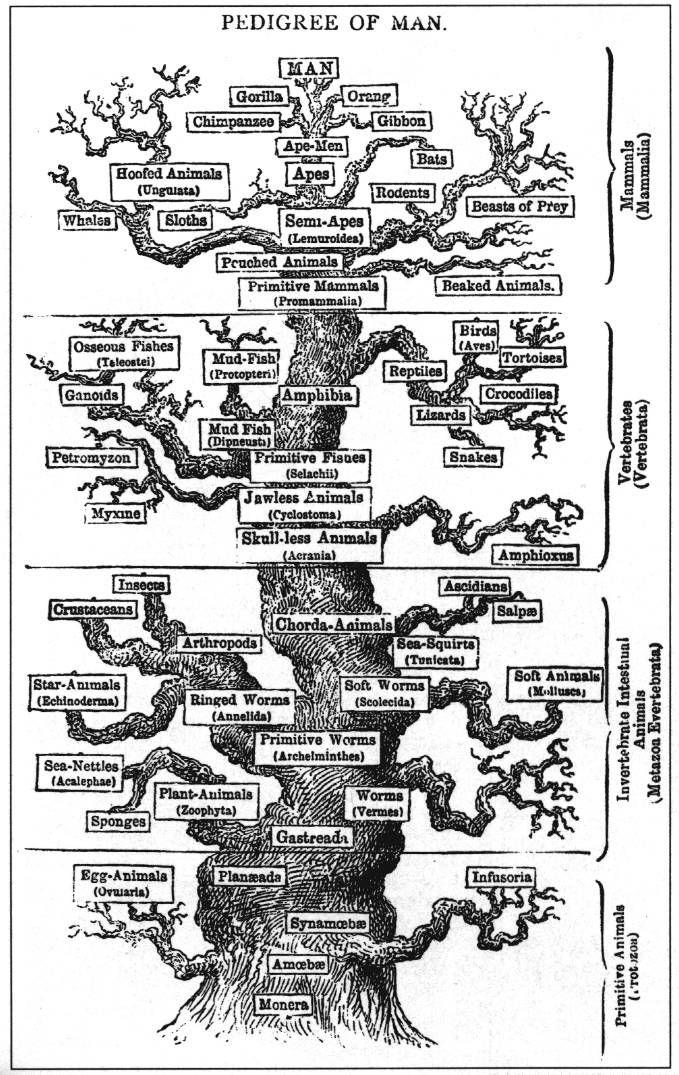
Pioneering phylogenetic thinking
E.Haeckel (1834–1919)
His phylogeny reflects the old idea of ’the Great Chain of Being’ with Man on top.
Progress and perfection
Evolution is working towards higher intelligent and moral order
Notes:
Ernst Haeckel made several tree of life years later which shows a more linear development from "lower" to "higher" species, with man on top. He developed the controversial recapitulation theory ("ontogeny recapitulates phylogeny") claiming that an individual organism's biological development, or ontogeny, parallels and summarizes its species' entire evolutionary development, or phylogeny.

Slide 6
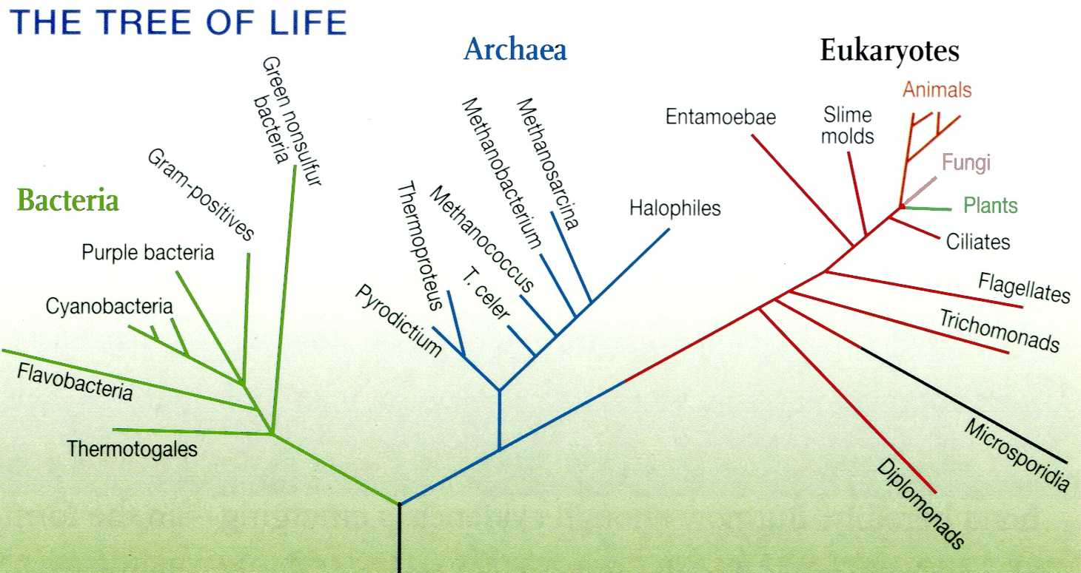
The tree of life
Notes:
There is not yet a consensus tree, and as we will see later some phenomenon can blur the picture

Slide 7
Phylogenetic Tree Terminology
Branches or
Lineages
Terminal Nodes
Internal Nodes
A
Represent the
TAXA (genes,
populations,
species, etc.)
used to infer
the phylogeny
B
Ancestral Node
C
D
E
outgroup

Slide 8
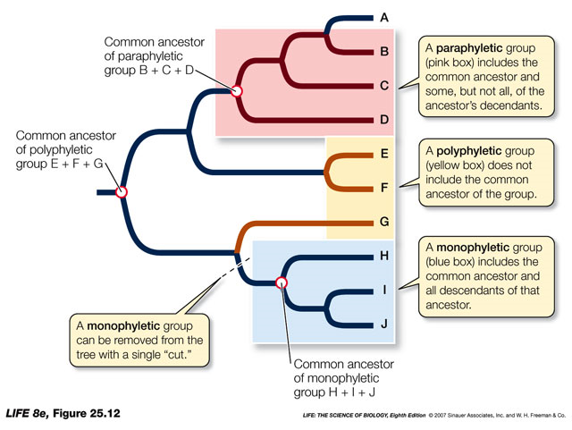
Monophyletic groups and clades

Slide 9
Systematics
Study of phylogenetics based on shared traits
Problem: not all shared traits are informative about evolutionary relationships
Notes:
Example: multicellularity, this is shared with so many species it does not tell us much. Hair….

Slide 10
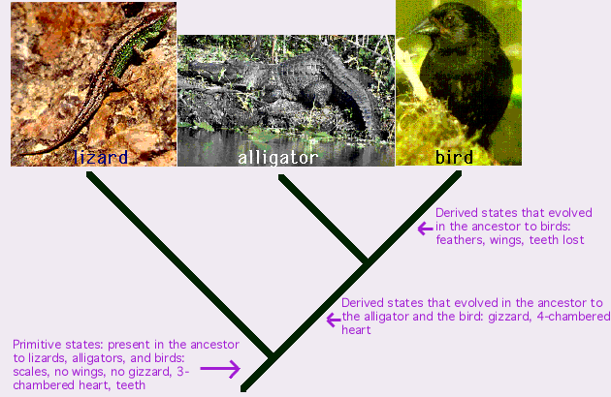
Cladistics
Study of phylogenetic relationships based on shared derived traits
Notes:
The following picture shows the relationships among three species: a lizard, an alligator, and a bird. If you simply look at their characteristics, a lizard and an alligator look very similar to each other -- that is why they are typically classified together as reptiles, while birds are classified into a different group (the birds.) Studies of phylogeny suggest, however, that alligators and birds are actually more closely related to each other than they are to lizards. This pattern of relationships is shown in the following tree, as are some of the characteristics people have used to study relationships among these species.

Slide 11
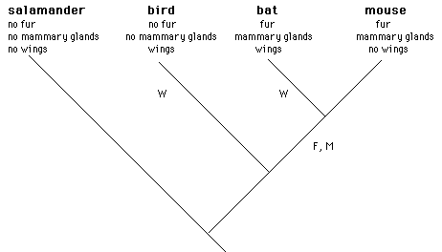
Caveat: homoplasy: independent evolution of the same character

Slide 12
DNA is a good tool for taxonomy
DNA sequences have advantages over taxonomic characters:
Unambiguous
Large numbers of characters can be scored for each individual

Slide 13
A aat tcg ctt cta gga atc tgc cta atc ctg
B ... ..a ..g ..a .t. ... ... t.. ... ..a
C ... ..a ..c ..c ... ..t ... ... ... t.a
D ... ..a ..a ..g ..g ..t ... t.t ..t t..
Each nucleotide difference is a character
Notes:
After working with sequences for a while, one develops an intuitive understanding that for a given gene, closely related organisms have similar sequences and more distantly related organisms have more dissimilar sequences. These differences can be quantified.

Slide 14
Sequences Reflect Relationships
Seq6
Seq5
Seq4
Seq3
Seq2
Seq1
time
… =derived mutations
Seq1
Seq2
Seq3
Seq4
Seq5
Seq6
Group1
Group2
Monophyly

Slide 15
Caveat: homoplasy: independent evolution of the same character
Evolutionary relationship:
Shared ancestral characters
Shared derived characters
Homoplasy (independent evolution of the same character):
C
C
G
G
C
G
C
G

Slide 16
Caveats: horizontal gene transfer
Common in prokaryotes (bacteria) and viruses: an organism incorporates genetic material from another organism
Exists in Eukaryotes: mitochondrial DNA or chloroplast DNA transferred to the nucleus
Notes:
any process in which an organism incorporates genetic material from another organism without being the offspring of that organism

Slide 17
Caveat: Orthologs vs. Paralogs
Orthologs are homologous genes in different species with analogous functions.
Paralogs are similar genes that are the result of a gene duplication.

Slide 18
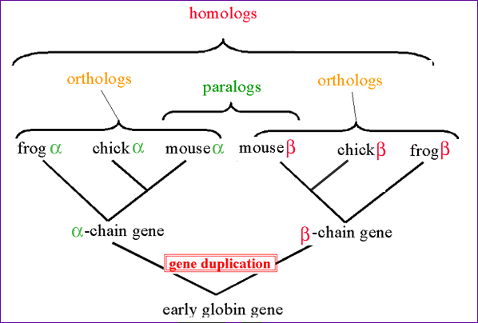
Caveats: Orthologs vs. Paralogs

Slide 19
What Sequences to Study?
Study more than just one region!
Different sequences evolve at different rates
Proteins
Highly variable sequences (ex: immunoglobulin genes)
Highly conserved (actin, rRNA coding regions)
Different regions within a single gene can evolve at different rates (conserved vs. variable domains)

Slide 20
Molecular Phylogenies
The gene compared must evolve at a rate comparable to the divergence time of the organism; for example:
18S rRNA gene for phylum-level divergences since it evolves very slowly.
Hemoglobin genes for mammalian orders.
Mitochondrial DNA for species divergences within a genus.
Repetitive DNA sequences (e.g. microsatellites) for individuals within species.

Slide 21
Tree Building Goals
Maximize shared derived character states in a lineage
Minimize homoplasies
Parallel changes, convergences, and reversals of character states between and within lineages

Slide 22
Tree building methods
Distance methods
Maximum Parsimony
Maximum likelihood
Bayesian inference
All methods can be used with different substitution models

Slide 23
Substitution models
A T
C G
Transitions
Transversions
Variation in rates
Notes:
substitution model describes the process from which a sequence of characters changes into another set of traits

Slide 24
Distance methods
Starts from a multiple sequence alignment
Makes a matrices of pairwise sequence distances (number of differences)
Builds a phylogenetic tree

Slide 25
Multiple sequence alignment
Species A ATGGCTATTCTTATAGTACG
Species B ATCTAGTCTTATATTACA
Aligned sequences
Species A ATGGCTATTCTTATAGTACG
Species B ATC --TAGTCTTATATTACA

Slide 26
Multiple sequence alignment
Different softwares: ClustalW, ClustalX, Muscle
Species A ATGGCTATTCTTATAGTACG
Species B ATC --TAGTCTTATATTACA
Minimize total score
Gap opening penalty
Mismatch
Gap extension penalty

Slide 27
Principle of distance methods
Taxa Characters
Species A ATGGCTATTCTTATAGTACG
Species B ATCGCTAGTCTTATATTACA
Species C TTCACTAGACCTGTGGTCCA
Species D TTGACCAGACCTGTGGTCCG
Species E TTGACCAGTTCTCTAGTTCG
Transform the sequence data into pairwise distances
A B C D E
Species A ---- 0.20 0.50 0.45 0.40
Species B ---- ---- 0.40 0.55 0.50
Species C ---- ---- ---- 0.15 0.40
Species D ---- ---- ---- ---- 0.25
Species E ---- ---- ---- ---- ----

Slide 28
Distance methods
UPGMA (Unweighted Pair Group Method with Arithmetic mean): same rate of evolution on each branch
The Neighbor Joining method = most popular method
does not assume the same rate of evolution on each branch of a tree

Slide 29
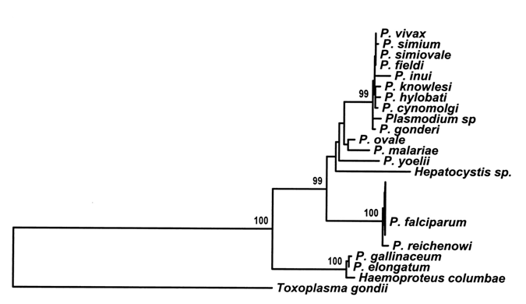
Resampling procedures: The Bootstrap
Randomly resample the data X-times and infer a phylogeny
Derive the frequency with which a particular node in the original tree appears in all of the resampled trees

Slide 30
Building Trees with Parsimony
Parsimony involves evaluating all possible trees and giving each a score based on the number of evolutionary changes that are needed to explain the observed data.
The best tree is the one that requires the fewest base changes for all sequences to derive from a common ancestor.

Slide 31
Hypothesis 1 on the evolution of lungs and swim bladder
(Phylogeny derived from other characters)
lungs evolved from swimbladder 3 times
swimbladder evolved from lungs 2 times
lungs lost with no replacement 1 time
lungs
swimbladder
sum: 6 evolutionary steps
placoderms
loss
elasmobranchs
gain
bichirs
prim rayfinned
gars
gain
gain
bowfins
gain
modern rayfinned
coelocanths
gain
lungfish
tetrapods

Slide 32
Hypothesis 2 on the evolution
of lungs and swim bladder
swimbladder evolved from lungs 2 times
lungs lost with no replacement 1 time
lungs
sum: 3 evolutionary steps
swimbladder
placoderms
loss
elasmobranchs
gain
bichirs
prim rayfinned
gars
bowfins
gain
modern rayfinned
coelocanths
lungfish
tetrapods
Notes:
Placodermi is a class of armoured prehistoric fish
Elasmobranchii is a subclass of Chondrichthyes or cartilaginous fish, that includes the sharks (Selachii) and the rays and skates (Batoidea).
The bichirs are a family, Polypteridae, of archaic-looking ray-finned fishes, the sole family in the order Polypteriformes.
All species occur in freshwater habitats in tropical Africa and the Nile River system, mainly swampy, shallow floodplains and estuaries.

Slide 33
Parsimonious evaluation
Hypothesis 1
lungs evolved from swimbladder 3 times
swimbladder evolved from lungs 2 times
lungs lost with no replacement 1 time
sum: 6 evolutionary steps
Hypothesis 2
swimbladder evolved from lungs 2 times
lungs lost with no replacement 1 time
sum: 3 evolutionary steps
Hypothesis 2 is preferred under the principle of parsimony

Slide 34
Maximum likelihood and bayesian methods
Allows for substitution rates to differ on lineages and sites: appropriate for distantly related species
Estimates the likelihood of a tree = probability of the data given an evolutionary model
Complex and computationally intensive!

